Slide 1

Python Data Types Overview Understanding Data Types in Python
Photo by Pexels

Slide 2
01
Introduction to Python Data Types
Table of Contents
02
Numeric Types
03
Sequence Types
04
Mapping Type
05
Set Types
06
Boolean Type
07
Special Data Types
08
Type Conversion in Python
09
Stay Updated
10
Acknowledgement

Slide 3

1
Introduction to Python Data Types
Overview
Python supports various data types defining operations and storage methods. Basic types include Numeric, Sequence, Mapping, Set, and Boolean types. Special types include None Type, Bytes, and Bytearray types for specific uses. Python provides type conversion functions for easy data type transformations.
Photo by Pexels

Slide 4

2
Numeric Types
Int, Float, Complex
Python supports int for whole numbers, float for decimal, and complex for real and imaginary numbers. Numeric examples: a=10 (int), b=3.14 (float), c=1+2j (complex). Numeric types allow mathematical operations with different precision levels. Numeric types are fundamental for scientific computing and data analysis in Python.
Photo by Pexels

Slide 5

3
Sequence Types
Str, List, Tuple
Sequence types like str for text, list for ordered collection, and tuple for immutable collection. Sequences examples: s="Hello, Python!" (str), l=[1,2,3,4,5] (list), t=(1,2,3,4,5) (tuple). Sequences are commonly used in handling text data, data structures, and algorithms in Python. Lists and tuples have different properties: mutability, order, and immutability.
Photo by Pexels

Slide 6
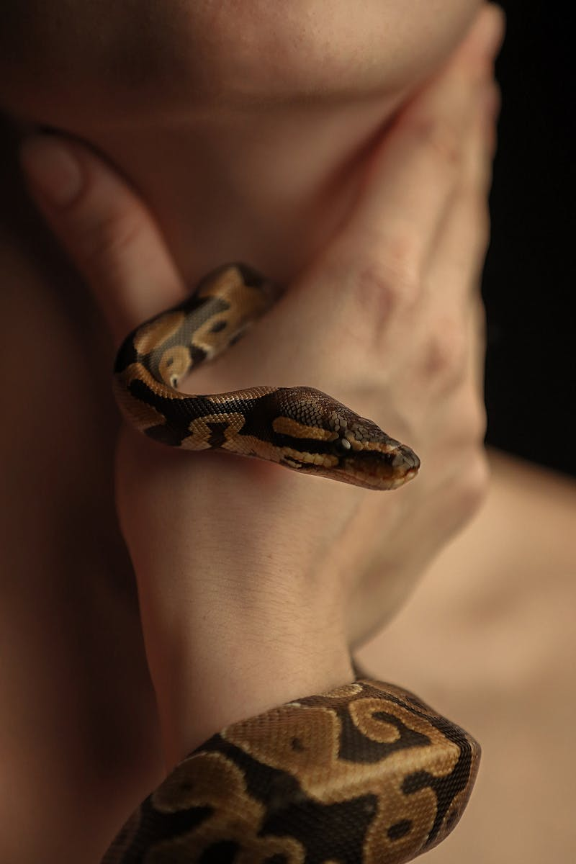
4
Mapping Type
Dictionary (Dict)
Python's mapping type is dict, an unordered collection of key-value pairs for data organization. Mapping example: d={"name":"Alice","age":25,"city":"New York"} Dictionaries are efficient for fast data retrieval and manipulation in Python programs. Dicts are widely used in storing data, configuration settings, and building data structures.
Photo by Pexels

Slide 7

5
Set Types
Set, Frozenset
Set types in Python include set and frozenset, offering collections of unique items without duplicates. Set examples: set1={1,2,3,4,5} (set), frozenset1=frozenset({1,2,3,4,5}) (frozenset). Sets are suitable for membership tests, mathematical operations, and removing duplicates from data collections. Frozensets are immutable sets used in scenarios requiring hashable, unchangeable collections.
Photo by Pexels

Slide 8

6
Boolean Type
Bool
The boolean type in Python, bool, represents True and False values for logical operations and conditions. Boolean example: is_valid=True Booleans are crucial for control flow, conditional statements, and logical operations in Python scripts. Boolean data types enable decision-making and branching in Python programming.
Photo by Pexels

Slide 9

7
Special Data Types
None, Bytes, Bytearray
Special data types like NoneType, bytes, and bytearray for distinct data handling purposes in Python. None Type represents absence of value; bytes and bytearray handle byte sequences efficiently. Examples: x=None (None Type), b=b"Hello" (bytes), ba=bytearray(b"Hello") (bytearray). These data types are used in specific scenarios like file handling, networking, and low-level operations in Python.
Photo by Pexels

Slide 10

8
Type Conversion in Python
Type Conversion Functions
Python provides built-in functions for seamless conversion between different data types for data manipulation. Examples: int(num_str) to convert string to integer, float(flt_str) for string to float, list(flt_str) to convert string to list. Type conversions are essential to handle user input, file interactions, and data processing in Python applications. Accurate type conversions ensure data integrity, compatibility, and error handling in Python scripts.
Photo by Pexels

Slide 11

9
Stay Updated
Repository Updates
Keep yourself updated by following the repository for new examples, enhancements, and Python-related content. Regular updates ensure access to the latest Python features, best practices, and programming techniques. Stay informed about Python community developments, libraries, and tools for efficient coding practices. Continuous learning and staying updated enhance your Python skills and expand your programming knowledge.
Photo by Pexels

Slide 12

10
Acknowledgement
Happy Coding
Celebrate your coding journey with joy and passion, embracing challenges, creativity, and learning in Python programming. Coding should be a fulfilling and rewarding experience, fostering innovation, problem-solving, and personal growth. Enjoy the process of coding, exploring new ideas, projects, and solutions in the Python programming domain. Code with enthusiasm, dedication, and curiosity, making a positive impact through your programming endeavors.
Photo by Pexels

